Slide 1







Interactive Explanations by Conflict Resolution
via Argumentative Exchanges
Antonio Rago, Hengzhi Li and Francesca Toni
Imperial College London
explAIn 2023
26th September 2023

Slide 2









Problem: The Lack of Interactivity in Explainable AI
Explainable AI (XAI) targets human understanding of AI models’ outputs.
Dominant methods include feature attribution ^{[Lundberg & Li, 2017]} and counterfactuals ^{[Wachter et al., 2018]}.
As AI advances, the demands on XAI are increasing: “Explanations are social…a transfer of knowledge, presented as part of a conversation or interaction.” ^{[Miller, 2019]}
However, current methods in XAI are often:
  Static;
  Shallow;
  Machine-centric.
Our research question: can argumentation help to resolve these issues?
Key
explanandum
machine contributions
human contributions
$e$: movie x is recommended
$$+$$
$$−$$
$m_{1}$: the acting in x is great
$h_{1}$: the directing in x is poor
$$+$$
$$−$$
Machine (μ)
$m_{2}$: actor b is great in x
$h_{2}$: actor a is poor in x
Human (η)

Slide 3

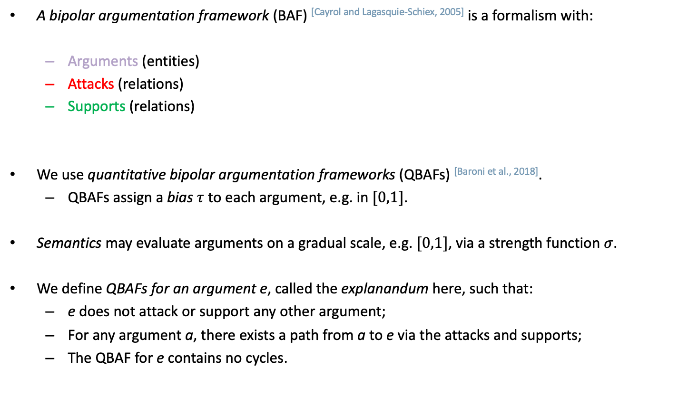





Background: Computational Argumentation
A bipolar argumentation framework (BAF) [Cayrol and Lagasquie-Schiex, 2005] is a formalism with:
  Arguments (entities)
  Attacks (relations)
  Supports (relations)
We use quantitative bipolar argumentation frameworks (QBAFs) ^{[Baroni et al., 2018]}.
  QBAFs assign a bias $τ$ to each argument, e.g. in $[0,1]$.
Semantics may evaluate arguments on a gradual scale, e.g. $[0,1]$, via a strength function $σ$.
We define QBAFs for an argument e, called the explanandum here, such that:
  e does not attack or support any other argument;
  For any argument a, there exists a path from a to e via the attacks and supports;
  The QBAF for e contains no cycles.
$$τ\left(a_{2}\right)=0.2$$
$$σ\left(a_{2}\right)=0.2$$
$$a_{2}$$
+
$$a_{1}$$
$$τ\left(a_{1}\right)=0.5$$
−
$$σ\left(a_{1}\right)=0.2$$
$$τ\left(a_{3}\right)=0.8$$
$$a_{3}$$
$$σ\left(a_{3}\right)=0.8$$

Slide 4



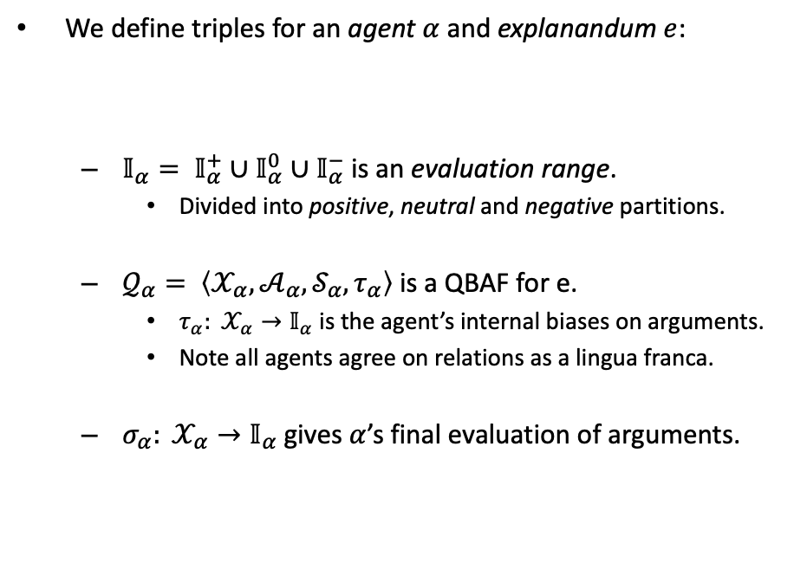

















Argumentative Exchanges (AXs)
We define triples for an agent $α$ and explanandum $e$:
  $𝕀_{α}= 𝕀_{α}^{+}∪𝕀_{α}^{0}∪𝕀_{α}^{−}$ is an evaluation range.
    Divided into positive, neutral and negative partitions.
  $𝒬_{α}= \left\langle 𝒳_{α},𝒜_{α},𝒮_{α},τ_{α}\right\rangle$ is a QBAF for e.
    $τ_{α}: 𝒳_{α}→𝕀_{α}$ is the agent’s internal biases on arguments.
    Note all agents agree on relations as a lingua franca.
  $σ_{α}: 𝒳_{α}→𝕀_{α}$gives $α$’s final evaluation of arguments.
Agent $α$
$$(𝕀_{α},𝒬_{α},σ_{α})$$
$$𝕀_{α}=[0,1]$$
$$𝕀_{α}^{−}=[0,0.5)$$
$$𝕀_{α}^{0}=\{0.5\}$$
$$𝕀_{α}^{+}=(0.5,1]$$
$$τ_{α}\left(e\right)=0.5$$
e
$$σ_{α}\left(e\right)=0.2$$
$$Σ_{α}\left(e\right)=−$$
$$−$$
$$+$$
a
b
$$τ_{α}\left(a\right)=0.8$$
$$τ_{α}\left(b\right)=0.2$$
$$σ_{α}\left(a\right)=0.8$$
$$σ_{α}\left(b\right)=0.2$$
$$Σ_{α}\left(a\right)=+$$
$$Σ_{α}\left(b\right)=−$$
Then, $α$’s stance on an argument is positive, neutral or negative depending on its strength:
$∀a∈𝒳_{α}:$ $Σ_{α}\left(e\right)=+$ iff $σ_{α}\left(a\right)∈𝕀_{α}^{+}$
$Σ_{α}\left(e\right)=0$ iff $σ_{α}\left(a\right)∈𝕀_{α}^{0}$
$Σ_{α}\left(e\right)=−$ iff $σ_{α}\left(a\right)∈𝕀_{α}^{−}$

Slide 5

































Argumentative Exchanges (Cont.)
We then define AXs for timestep $0≤t≤n$:
  $ℬ_{x}^{t}$ is the exchange BAF;
  Each agent has a private triple;
  We assume that a conflict exists between agents’ stances on e.
As the timestep $t$ progresses:
  Agents contribute relations from their private QBAF which attack/support arguments in $ℬ_{x}^{t}$;
  Agents learn any unseen arguments added to the exchange BAF and assign them biases;
  Agents’ stances on $e$may thus change and the conflict may be resolved.
Private to μ
Public to μ and η
Private to η
μ’s Private QBAF $𝒬_{μ}^{t}$
Exchange BAF $ℬ_{x}^{t}$
η’s Private QBAF $𝒬_{η}^{t}$
e
$$t=0$$
e
$$t=1$$
e
$$t=3$$
$$t=0$$
$$t=1$$
$$t=2$$
$$t=1$$
$$t=2$$
$$t=2$$
$$t=3$$
$$t=0$$
$$t=3$$
$$−$$
$$+$$
$$−$$
$$+$$
$$−$$
$$+$$
a
b
a
b
$$←(b,e)$$
a
b
$$(c,a) →$$
$$←\left(d,a\right)$$
$$←\left(d,a\right)$$
$$(a,e) →$$
$$(c,a) →$$
$$+$$
$$−$$
$$+$$
$$−$$
$$+$$
$$−$$
$$+$$
c
d
c
d
c
d
f

Slide 6
Theoretical and Simulation-Based Evaluation of AXs
Novel theoretical properties for interactive explanations, which are satisfied for certain cases:
  Resolution representation – in a resolved AX, the exchange BAF must contain arguments which demonstrate how the resolution was achieved;
  Conflict representation – in an unresolved AX, the exchange BAF must contain arguments which demonstrate where the conflict lies.
In multi-agent simulations with a machine explaining to a human, we prove some hypotheses, e.g.:
  When the machine uses static, shallow explanations, as the human’s confirmation bias increases, resolution rate decreases.
  When the machine uses interactive explanations, resolution rate increases relative to shallow, static explanations.
  When the machine uses interactive explanations, selecting the arguments argumentatively increases resolution rate and contribution accuracy relative to selecting greedily.

Slide 7
Conclusions & Future Work
We introduced the novel concept of AXs:
  Defined generally but deployed in XAI, where a machine explains to a human;
  Demonstrated properties of interactive explanations based on conflict resolution;
  Defined agent behaviour and proved hypotheses, e.g. the strongest argument may not always be the most effective.
Opens several potentially fruitful avenues for future work:
  More experiments with different contexts, restrictions and relaxations;
  User studies to examine how well agents with QBAFs can model human behaviour;
  We have deployed AXs in image classification where AI models debate one another.
Thanks for your attention!

