Slide 1


The CLEAR Project
Counterfactual
Local
Explanations
viA
Regression
Adam White
Artur d’Avila Garcez
13th November 2019

Slide 2
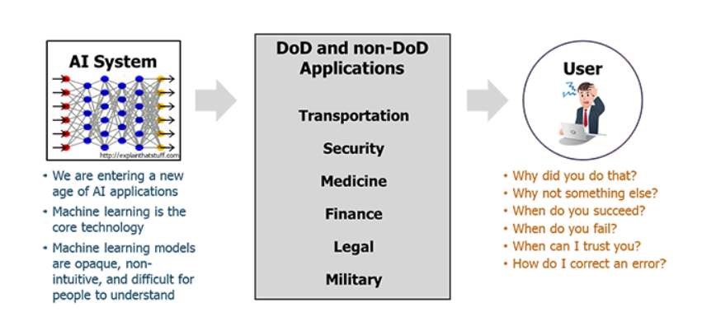


The CLEAR Project
The Need For Explainable AI

Slide 3



The CLEAR Project
Explainable AI is Big Business

Slide 4


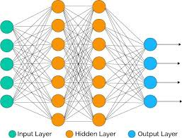


The CLEAR Project
Predictive Accuracy is Not Enough
Hospitalise
Send home
Patient data
Neural Network
Probability of death
Intelligible Models for HealthCare: Predicting Pneumonia Risk and Hospital 30-day Readmission - Caruana et al. (2015)

Slide 5
The CLEAR Project
Approaches to Explaining AI
Transparent
(how the model functions internally)
Black box
(how the model behaves)
Explainable AI
Global
Local

Slide 6
The CLEAR Project
State of the Art Method 1: b-counterfactuals
b-counterfactuals explain a single prediction by identifying ‘close possible worlds’ in which an individual receives the prediction they desired.
‘Mr Jones would have received his loan, if his annual salary had been $35,000 instead of the $32,000 he currently earns.’
(Wachter et al. 2017)

Slide 7
The CLEAR Project
State of the Art Method 1: b-counterfactuals
b-counterfactuals explain a single prediction by identifying ‘close possible worlds’ in which an individual receives the prediction they desired.
‘Mr Jones would have received his loan, if his annual salary had been $35,000 instead of the $32,000 he currently earns.’
(Wachter et al. 2017)
Suppose Mr Jones was assigned a probability of 0.75 for defaulting on a loan.
A satisfactory explanation also needs to explain:
why Mr Jones was assigned a score of 0.75. This would include identifying the contribution that each feature made to the score.
how the features interact with each other. For example, if he had been in present job > 2 years he would only have needed a salary of $33,000

Slide 8

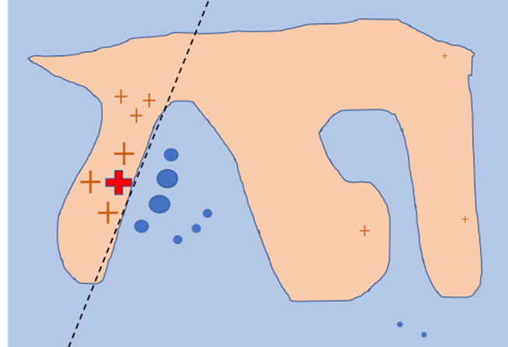
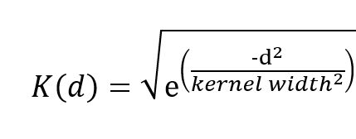
The CLEAR Project
State of the Art Method 2: LIME
Local Interpretable Model-Agnostic Explanations
The LIME algorithm:
Consider a model m whose prediction y for observation x is to be explained.
generates a dataset of synthetic observations;
labels the synthetic data by passing it to the model m;
weights the synthetic observations using the kernel:
where d is the Euclidean distance from x to the synthetic
observation;
(4) produces a locally weighted regression.
The regression coefficients are meant to explain prediction y.
Riberio et al. (2016)

Slide 9
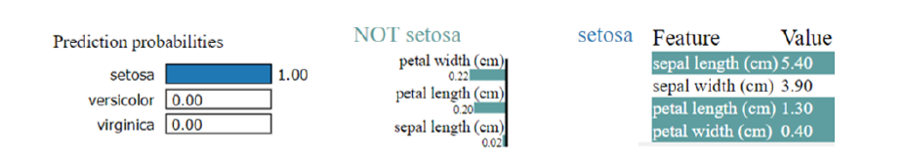
The CLEAR Project
LIME does not measure its fidelity

Slide 10
The CLEAR Project
LIME does not measure its fidelity
Regression scores:
setosa 0.54
versicolor 0.47
virginica -0.02

Slide 11


The CLEAR Project
Key Requirements for Satisfactory Explanation
"Suppose that M is an explanandum consisting in the statement that some variable
Y takes the particular value y. Then an explanans E for M will consist of (a) a
generalization G relating changes in the value(s) of a variable X (where X may
itself be a vector or n-tuple of variables X_{i}) with changes in Y, and (b) a statement
(of initial or boundary conditions) that the variable X takes the particular value x."
A satisfactory explanation consists in showing patterns of counterfactual dependence.
It needs to include an equation relating a prediction Y to its features X
(Woodward 2003)
A satisfactory explanation of a prediction needs to:
  explain the value of that prediction and answer ’what-if-things-had-been-different’ questions.
  Measure its fidelity. It must know when it does not know

Slide 12

The CLEAR Project
Counterfactual Local Explanations viA Regression
Provides local explanations:
with b-counterfactuals and the corresponding regression equation;
using the values of b-counterfactuals to significantly improve the fidelity of its regressions;
that report their fidelity

Slide 13
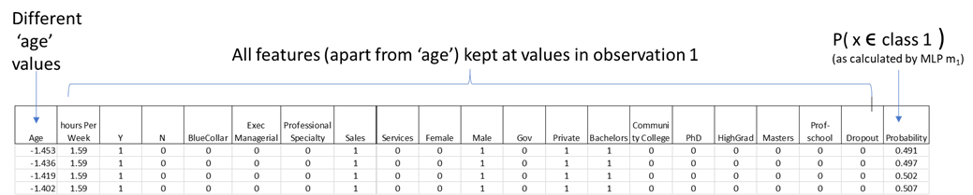
The CLEAR Project
The CLEAR Method:
Determine observation $x$‘s b-perturbations.
b-perturbation: the minimum change to a feature f needed to change ML system's prediction to a target class (all other features being kept constant)
For the b-counterfactual that Mr Jones would have received his loan if his salary had been $35,000, a w-perturbation for salary is $3000.

Slide 14
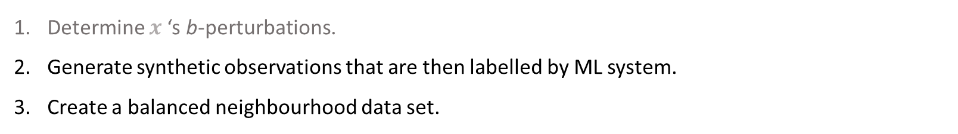
The CLEAR Project
The CLEAR Method:
Determine $x$‘s b-perturbations.
Generate synthetic observations that are then labelled by ML system.
Create a balanced neighbourhood data set.

Slide 15
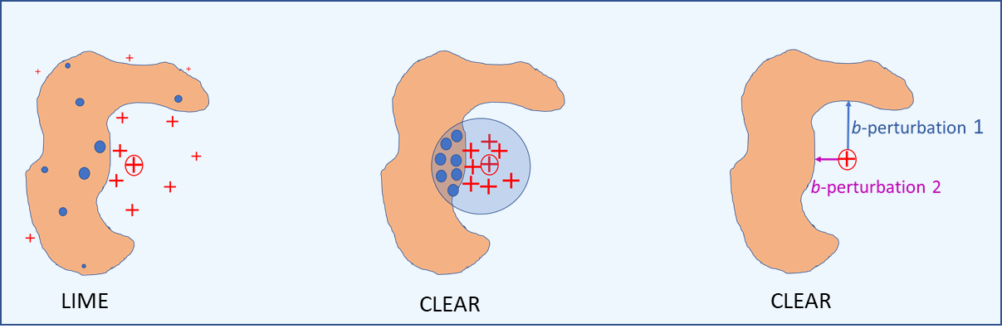
The CLEAR Project
The CLEAR Method:
Determine $x$‘s b-perturbations.
Generate synthetic observations that are then labelled by ML system.
Create a balanced neighbourhood data set.

Slide 16
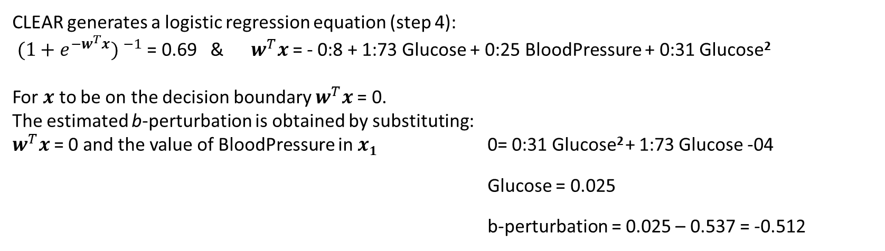
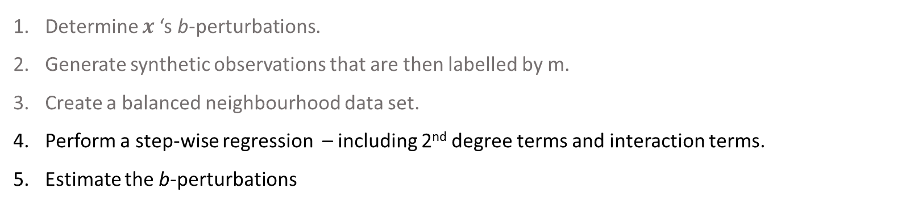
The CLEAR Project
The CLEAR Method:
Determine $x$‘s b-perturbations.
Generate synthetic observations that are then labelled by m.
Create a balanced neighbourhood data set.
Perform a step-wise regression – including 2nd degree terms and interaction terms.
Estimate the b-perturbations
MLP on toy Pima dataset $x$= {Glucose: 0.537, BloodPressure: 3.1} $PMLP(x ε class1)$= 0.69
CLEAR generates a logistic regression equation (step 4):
${(1+e^{−w^{T}x}) }^{−1}$ = 0.69 & $w^{T}x$= - 0:8 + 1:73 Glucose + 0:25 BloodPressure + 0:31 Glucose²
For $x$ to be on the decision boundary $w^{T}x$= 0.
The estimated b-perturbation is obtained by substituting:
$w^{T}x$= 0 and the value of BloodPressure in $x1$ 0= 0:31 Glucose² + 1:73 Glucose -04
Glucose = 0.025
b-perturbation = 0.025 – 0.537 = -0.512

Slide 17
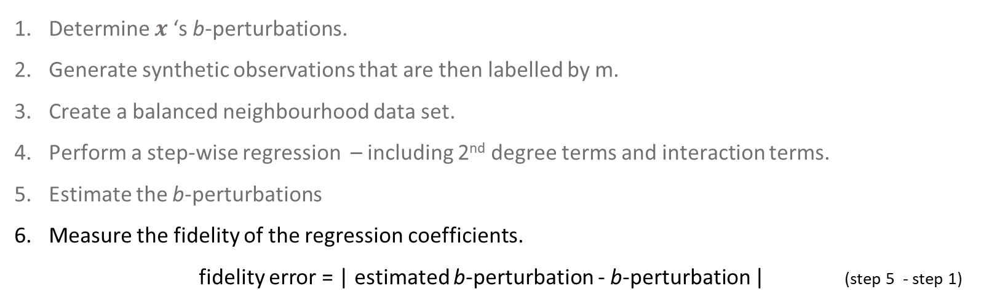
The CLEAR Project
The CLEAR Method:
Determine $x$‘s b-perturbations.
Generate synthetic observations that are then labelled by m.
Create a balanced neighbourhood data set.
Perform a step-wise regression – including 2nd degree terms and interaction terms.
Estimate the b-perturbations
Measure the fidelity of the regression coefficients.
        fidelity error = | estimated b-perturbation - b-perturbation | (step 5 - step 1)
estimated b-perturbation (step 5) = -0.512
actual b-perturbation (step 1) = -0.557
fidelity error = 0.045

Slide 18
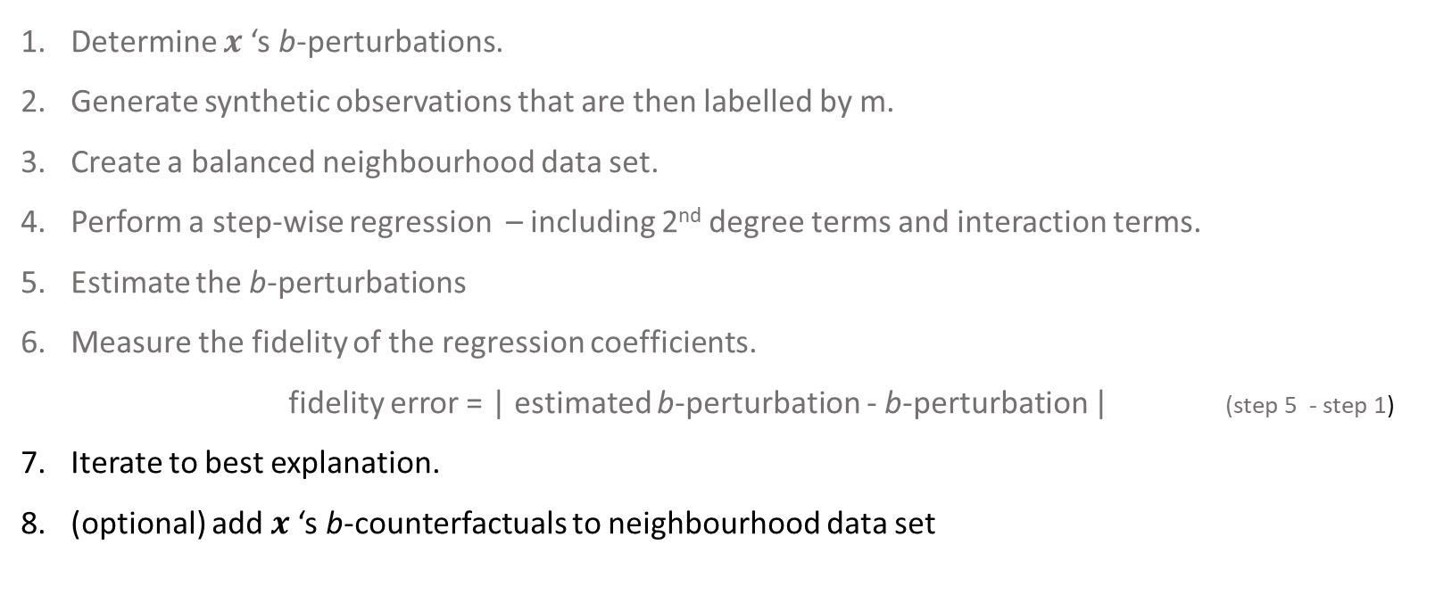
The CLEAR Project
The CLEAR Method:
Determine $x$‘s b-perturbations.
Generate synthetic observations that are then labelled by m.
Create a balanced neighbourhood data set.
Perform a step-wise regression – including 2nd degree terms and interaction terms.
Estimate the b-perturbations
Measure the fidelity of the regression coefficients.
        fidelity error = | estimated b-perturbation - b-perturbation | (step 5 - step 1)
Iterate to best explanation.
(optional) add $x$‘s b-counterfactuals to neighbourhood data set

Slide 19
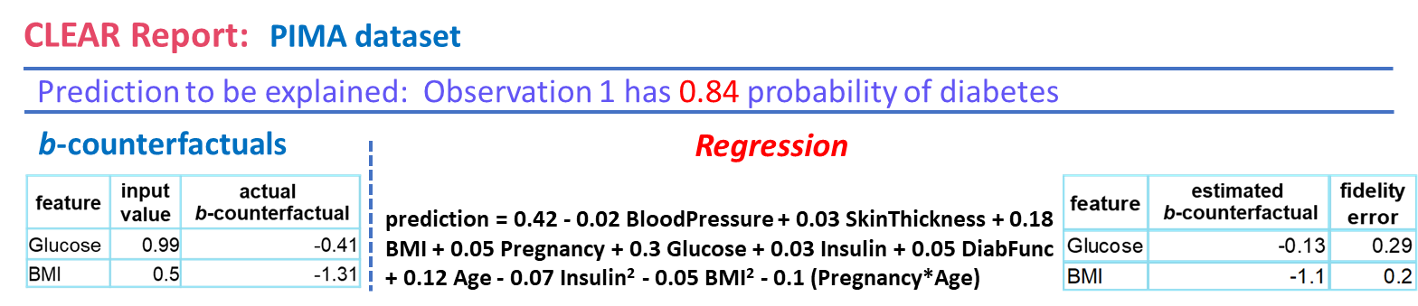
The CLEAR Project
An Example of CLEAR’s Output:

Slide 20
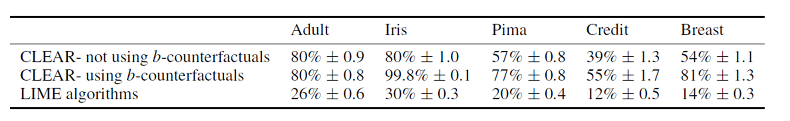
The CLEAR Project
CLEAR has much higher fidelity than LIME:
% of perturbations with fidelity error < 0.25 σ

Slide 21
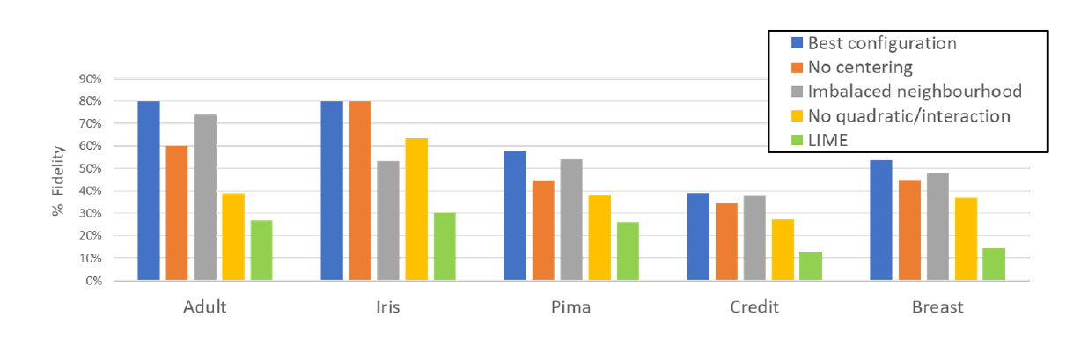
The CLEAR Project
CLEAR has much higher fidelity than LIME:
% of perturbations with fidelity error < 0.25 σ
Num. variables vs % Fidelity
Different configurations

Slide 22
The CLEAR Project
Next Steps
identify multi-feature b-counterfactuals
determine fidelity neighbourhoods
compare (possibly add) ‘anchor’ functionality
usage trial

